Slide 1
Assumptions
Potential Power Generated from Solar
Residential Power Consumption
Solar Exposure
The total amount of solar radiation that reaches the earth surface in a day.
Source: Bureau of Meteorology
Units: MJ / m2

Slide 2

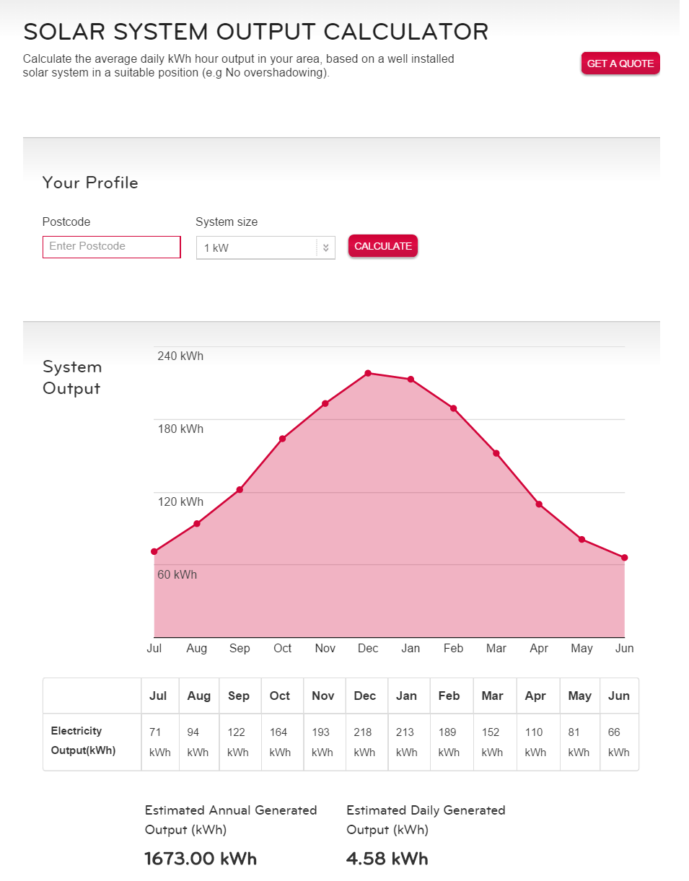
Potential Solar power generated per suburb
=
Rated Power per m²
x
Panel output Derate Factor
x
Peak Sunshine Hours per day
x
Usable Roof Area per suburb
The total roof area available for solar panel installation.
Total building footprint area x usable area factor = Total usable roof area
Usable area factor = 15%
Factors considered
Average roof pitch
Roof orientation
Shading
Data Sources
Landgate's SLIP Resedential Building Polygon Data
The maximum power output of a solar panel per square meter.
150 W/m²
The ratio that converts the maximum power out to the actual power output per square meter of a solar panel.
0.85
Factors considered:
Manufacturer’s tolerance
Operating temperature of the solar panel
Dust
Peak sunshine hours is the equivalent number of hours at 1000W/m2 of the power of the sun it would take to reach a particular level.
Average Solar Exposure per day / 3.6 = Peak Sunshine Hours
Data Sources
Bureau of Meteorology – average solar exposure per day per month in WA
https://www.lgenergy.com.au/solar-calculators/solar-system-output-calculator
The estimates used above were justified using the LG Solar system calculator. This calculator provides the daily energy generated for different sized LG solar energy solar panels.

Slide 3
A MWh / m² / day
Solar energy generated per square meter of solar panels per day
B m²
Usable roof area solar panels can be installed on
C MWh / day
Usable roof area solar panels can be installed on
x
=
A = K x D x PSH
K = average rated power per square meter = 150 W / m²
This is the maximum power output per square meter of solar panels
D = derated rated power output factor = 0.85
Factors considered include:
Manufacturer’s tolerance
Operating temperature of the solar panel
Dust
PSH = Peak Sunshine Hours
Peak sunshine hours is the equivalent number of hours at 1000W/m2 of the power of the sun it would take to reach a particular level. Average Solar Energy per day was obtained from the Bureau of Meteorology.
B = BF x UA
BF = Total building footprint area per suburb
The total building footprint area per suburb was calculated using building footprint data from Landgate’s SLIP information and suburb boundary information. Building footprint polygons were exported, classified by suburb and the areas of these polygons were summed for each suburb.
UA = Usable roof area factor = 0.15
Only a proportion of a building’s footprint area is usable for solar panels. This factor has been estimated based on the following factors:
Roof orientation: North facing roofs are optimal for solar panels, East and West facing roofs can only operate at a maximum of 85% of rated power output, and South facing roofs shouldn’t be used.
Dust: the accumulation of dust on solar panels will reduce the operating efficiency of the panel
Shade

Slide 4
E MWh / day / house
Average household consumption by suburb
F
Number of households by suburb
D MWh / day
Total energy consumption by suburb
x
=
E
Synergy data covering average household energy consumption by suburb
F = NR + AD
NR = Number of residential buildings by building footprint
The number of residential buildings was calculated using building footprint data from Landgate’s SLIP information and suburb boundary information. Building footprint polygons were exported, intersected with boundary information and counted.
AD = Apartment Density Correction
The apartment density correction was calculated using building height data. For buildings taller than 13 metres, we used average apartment size to correct for the number of apartments likely to be missing from our initial calculations.
Assumptions:
Average storey height = 3.1m
Average apartment size = 90 m²

